Slide 1

S.B. JAIN INSTITUTE OF TECHNOLOGY , MANAGEMENT
& RESEARCH ,NAGPUR
Department Of Emerging Technologies (AI&ML and AI&DS)
Project Title : Sentiment Analysis on Interactive Conversational
Agent/Chatbots
Team Members : Falguni kalambe (AM21053)
Samyak Mnwatkar (AM22D002)
Yash Kakde (AM22D005)
Vidit Khairkar (AM22D006)
Guide : Prof. Ravi Asati
Date : 5 Sep 2024

Slide 2
Project Overview -
We'll explore the key features and benefits of an AI- Powered Departmental Information Assistant, its impact on the College & Department will be beneficial for students, parents, teaching and non-teachingstaff as well. Presently,there are various chatbots available for the students. But our chatbot “Bandhu” is designed for the students to ask Department related question.For this system a algorithm is developed to deliver an appropriate response to the user corresponding to their entered Message.
Objectives -
Consistency and Accuracy: The AI assistant can provide consistent and accurate information to all employees, ensuring that everyone has access to the same knowledge base. This can help prevent misunderstandings and discrepancies within the department.
24/7 Availability: Unlike human assistants who may have limited availability, an AI-powered assistant can be accessible 24/7, allowing employees to seek assistance and information at any time.
Productivity: By automating routine inquiries and providing instant access to information, the AI-powered assistant can help employees complete tasks more efficiently and effectively. This can lead to increased productivity and better outcomes for the department.

Slide 3
Background Information -
A chatbot is a software that is used to interact between a computer and a human in natural
language like humans chat . Chatbots chat with the user in a conversation in place of a human and reply to the user. The goal was to resemble a human being in the way they interact, trying to make the user think he is chatting with another human being. The chat bot application helps the students to access the university related information from anywhere with internet connection. This system reduces work of college administration providing information to students and also reduces the workload on the staff to answer all the queries of the students. Sentiment analysis , It enhances user experience by enabling chatbots to understand emotions, personalize responses, and adapt in real-time. Sentiment analysis in chatbots is a natural language processing (NLP) technique that determines if user input is positive, negative, or neutral.
Related Work -
“ Chatbot Optimization using Sentiment Analysis and Timeline Navigation “ - Journal of Theoretical and Applied Informatics
In this work, present a chatbot-building framework that considers the sentiment and interaction timeline of the user to provide a more precise answer. Using sentiment analysis the chatbot can check the feedback from the user’s answer, and by using a timeline structure, it can avoid repeating the same previous mistakes as most common chatbots tend to make.

Slide 4
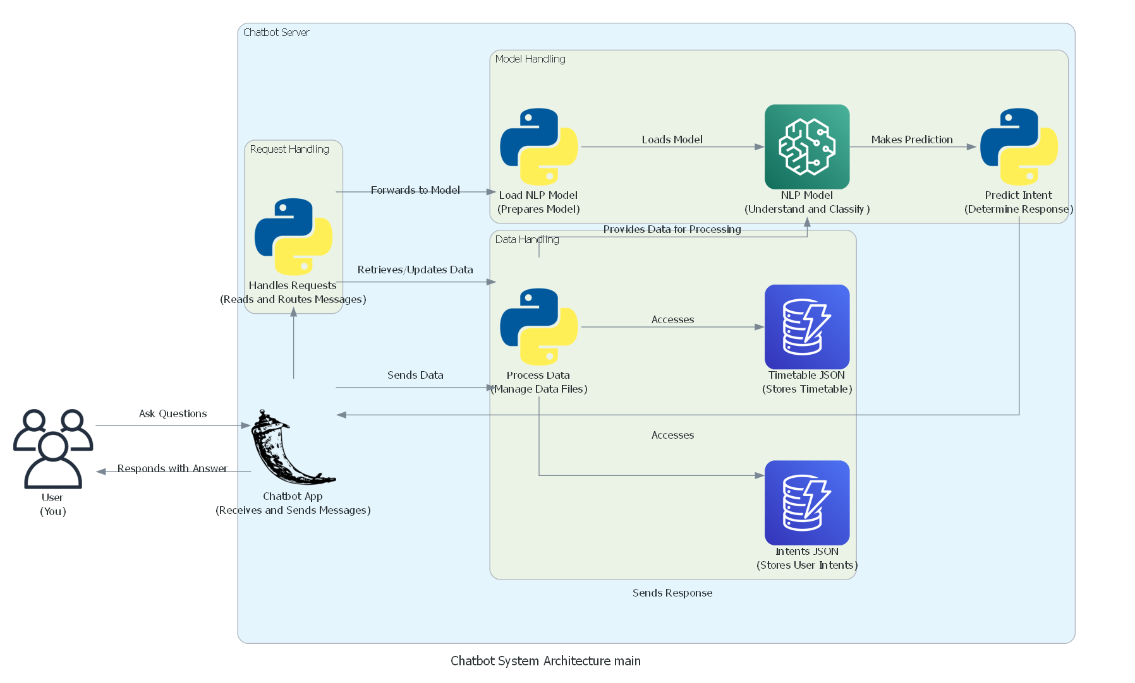
Approch -
Tools & Technologies Used -
Tools – VScode
Technologies –
Programming Languages: Python (backend), JavaScript (frontend)
Frameworks: Django/Flask (backend), React.js (frontend),
NLP Library: Nltk
APIs:

Slide 5
Completed Task -
Bot Ready
Sentimental Analysis API Ready
Voice Based Ready
Milestones Achieved -

Slide 6
Ongoing Work -
Sentiment Analysis,we show that these new features make difference in the chatbot development and even create better checkpoints to redirect users to a human attendant. Improving Contextual Understanding, Researchers are working on enhancing chatbots' ability to understand context better, ensuring more accurate sentiment analysis, especially in complex conversations. Efforts are being made to mitigate biases in sentiment analysis algorithms, ensuring fair and unbiased chatbot interactions.
Challenges Faced -
Data Quality and Integration: Ensuring that the AI assistant has access to accurate and up-to-date information requires integrating data from multiple sources within the department. However, data may be scattered across different systems, in various formats, and may suffer from inconsistencies or inaccuracies.
Natural Language Understanding (NLU): Developing NLU capabilities that allow the AI assistant to accurately interpret and respond to natural language queries is challenging. Understanding the nuances, context, and intent behind user inquiries requires sophisticated AI algorithms and extensive training data.
Being Fair to Everyone: We have to make sure the AI doesn't treat people unfairly or show biases. It should treat everyone the same way.

Slide 7
Next Steps -
The future development is to extend the developed sentiment analysis predictive model to various decision making systems that require consideration of human factors.
Voice Command Control
Real Time Attendance
Timeline -

Slide 8
Summary -
The development and implementation of the departmental chatbot represent a significant milestone in enhancing communication, efficiency, and user experience within the departmental ecosystem. Through meticulous planning, collaboration, and innovation, the project has successfully addressed the diverse communication needs of students, faculty, staff, and administrators.
The departmental chatbot serves as a centralized and accessible resource, providing instant assistance and information retrieval for various inquiries, ranging from course-related questions to administrative procedures and resource lookup. Its intuitive interface and natural language processing capabilities have transformed the way stakeholders interact with departmental services, offering convenience and responsiveness round the clock.
Questions & Feedback -

Slide 9
Citations -
“Chatbot Optimization using Sentiment Analysis and Time / Navigatio”- Journal of Theoretical and Applied Informatics (2023)
“Sentiment-based Chatbot using Machine Learning for Recommendation System”- Research Square (National Formosa University) (2022)
“Sentimental Analysis based on Text and Emoticons”- International Journal of Innovative Technology and Exploring Engineering (2020)
“Sentimental Analysis on Text data by using Unsupervised Methods”- International Journal of Engineering and Advanced Technology
Acknowledgements -

